Slide 1
Online Algorithms
Ram Krishna Dahal
Asst. Professor
Central Department of computer science and IT, TU

Slide 2
Introduction
Online Algorithms are algorithms that need to make decisions without full knowledge of the input. They have full knowledge of the past but no (or partial) knowledge of the future.
For this type of problem we will attempt to design algorithms that are competitive with the optimum offline algorithm, the algorithm that has perfect knowledge of the future.

Slide 3
The Ski-Rental Problem
Assume that you are taking ski lessons. After each lesson you decide (depending on how much you enjoy it, and what is your bones status) whether to continue to ski or to stop totally
You have the choice of either renting skis for 1$ a time or buying skis for y$.
Will you buy or rent?

Slide 4
The Ski-Rental Problem
If you knew in advance how many times t you would ski in your life then the choice of whether to rent or buy is simple. If you will ski more than y times then buy before you start, otherwise always rent
The cost of this algorithm is min(t, y).
This type of strategy, with perfect knowledge of the future, is known as an offline strategy.

Slide 5
The Ski-Rental Problem
In practice, you don't know how many times you will ski. What should you do?
An online strategy will be a number k such that after renting k-1 times you will buy skis (just before your kth visit).
Claim: Setting k = y guarantees that you never pay more than twice the cost of the offline strategy.
Example: Assume y=7$ Thus, after 6 rents, you buy. Your total payment: 6+7=13$

Slide 6

The Ski-Rental Problem
Theorem: Setting k = y guarantees that you never pay more than twice the cost of the offline strategy.
Proof: when you buy skis in your kth visit, even if you quit right after this time, t $≥$ y.
Your total payment is k-1+y =2y-1.
The offline cost is min(t, y) = y.
The ratio is (2y-1)/y = 2-1/y.
We say that this strategy is (2-1/y)-competitive.

Slide 7

Competitive Ratio
An on-line algorithm A is c-competitive if there is a constant b for all sequences s of operations A(s) $≤$ c OPT(s) + b where A(s) is the cost of A on the sequence s and OPT(s) is the optimal off-line cost for the same sequence.
Competitive ratio is a worst case bound.

Slide 8
The Ski-Rental Problem
Is there a better strategy?
Let k be any strategy (buy after k-1 rents).
Suppose you buy the skis at the kth time and then break your leg and never ski again.
Your total ski cost is k-1+y and the optimum offline cost is min(k,y).
For every k, the ratio (k-1+y)/min(k,y) is at least (2-1/y)
Therefore, every strategy is at least (2-1/y)- -competitive

Slide 9
The Ski-Rental Problem
The general rule: When balancing small incremental costs against a big one-time cost, you want to delay spending the big cost until you have accumulated roughly the same amount in small costs.

Slide 10
Paging- Cache Replacement Policies
Problem Statement:
There are two levels of memory: – fast memory M1 consisting of k pages (cache) – slow memory M2 consisting of n pages (k < n).
Pages in M1 are a strict subset of the pages in M2.
Pages are accessible only through M1 .
Accessing a page contained in M1 has cost 0.
When accessing a page not in M1, it must first be brought in from M2 at a cost of 1 before it can be accessed. This event is called a page fault.

Slide 11
Paging- Cache Replacement Policies
Problem Statement: If M1 is full when a page fault occurs, some page in M1 must be evicted in order to make room in M1. How to choose a page to evict each time a page fault occurs in a way that minimizes the total number of page faults over time?

Slide 12
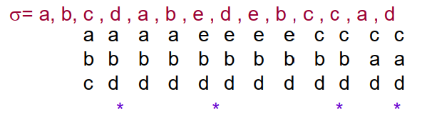
Paging- An Optimal Offline Algorithm
Algorithm LFD (Longest-Forward-Distance) An optimal off-line page replacement strategy. On each page fault, replace the page in M1 that will be requested farthest out in the future. Example: M2={a,b,c,d,e} n=5, k=3
4 cache misses in LFD

Slide 13
Paging- An Optimal Offline Algorithm
A classic result from 1966: LFD is an optimal page replacement policy.
Proof idea: For any other algorithm A, the cost of A is not increased if in the 1st time that A differs from LFD we evict in A the page that is requested farthest in the future.
However, LFD is not practical. It is not an online algorithm!

Slide 14
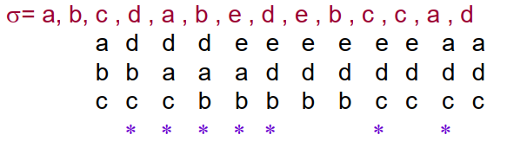

Online Paging Algorithms
FIFO: first in first out: evict the page that was enteredfirst to the cache. Example: M2={a,b,c,d,e} n=5, k=3
7 cache misses in FIFO
Theorem: FIFO is k-competitive: for any sequence, #misses(FIFO)$≤$ k #misses (LFD)

Slide 15
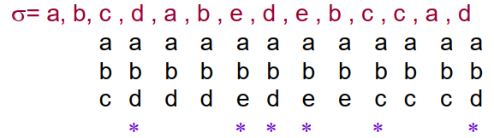

Online Paging Algorithms
LIFO: last in first out: evict the page that was enteredlast to the cache. Example: M2={a,b,c,d,e} n=5, k=3
6 cache misses in LIFO
Theorem: For all n>k, LIFO is k competitive: For any k, there exists a sequence of requests such that #misses(LIFO) $≤$ k #misses (LFD)

Slide 16
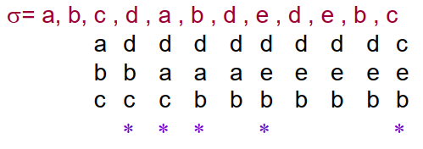
Online Paging Algorithms
LRU: least recently used: evict the page with the earliest last reference. Example: M2={a,b,c,d,e} n=5, k=3
5 cache misses in LRU
Theorem: LRU is k-competitive

Slide 17

Paging- a bound for any deterministic online algorithm
Theorem: For any k and any deterministic on-line algorithm A, the competitive ratio of A $≥$ k.
Proof: Assume n= k+1 (there are k+1 distinct pages). What will the adversary do? Always request the page that is not currently in M1 This causes a page fault in every access. The total cost of A is |$σ$|.

Slide 18

Paging- a bound for any deterministic online algorithm
What is the price of LFD in this sequence?
At most a single page fault in any k accesses (LFD evicts the page that will be needed in the k+1th request or later)
The total cost of LFD is at most |$σ$|/k.
Therefore: Worst-case analysis is not so important in analyzing paging algorithm
Can randomization help? Yes!!

Slide 19

Online Scheduling and Load Balancing
Problem Statement:
A set of m identical machines,
A sequence of jobs with processing times p1, p2,….
Each job must be assigned to one of the machines.
When job j is scheduled, we don’t know how many additional jobs we are going to have and what are their processing times.
Goal: schedule the jobs on machines in a way that minimizes the
$makespan=\max_{i}\sum_{j on m_{i}}{P_{j}}$. (the maximal load on one machine)

Slide 20
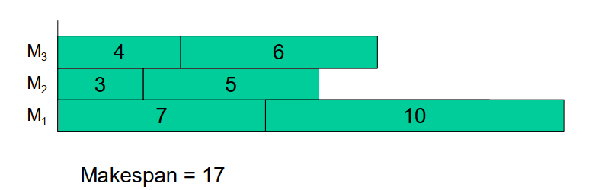

Online Scheduling and Load Balancing
List Scheduling: A greedy algorithm: always schedule a job on the least loaded machine
Example: m=3 $σ$= 7 3 4 5 6 10

Slide 21
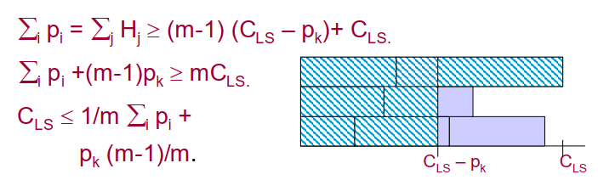

Online Scheduling and Load Balancing
Theorem: List- Scheduling is (2-1/m)- competitive.
Proof: Let $H_{j}$ denote the last completion time on the j^{th} machine. Let k be the job that finishes last and determines C_{LS}. All the machines are busy when j starts its processing, thus,
$$∀j,H_{j}≥C_{LS}−P_{k}$$
For at least one machine (that processes k) $H_{j}=C_{LS}$.

Slide 22
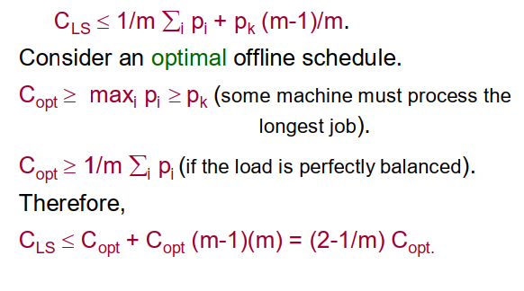
Online Scheduling and Load Balancing

